Slide 1

ICAWEB425A Apply structured query language to extract and manipulate data
ICADBS403A Create basic databases
ICAICT407A Maintain website information standards
Copyright © 2012 Kent Institute of Business & Technology, Sydney
CIV03 - Website Design 2(Design and Development)
CIV03 - Website Design 2
(Design & Development)

Slide 2
Learning Outcomes:
MySQL Aggregate Functions
  Group By
  Count
  Sum
  Avg
  Min
  Max
MySQL Join table
Copyright © 2012 Kent Institute of Business & Technology, Sydney
CIV03 - Website Design 2(Design and Development)

Slide 3
Aggregate Functions
Aggregate means constituting or amounting or part of a whole
The most common types of aggregate functions let you find out things like the minimum, maximum and even the average of a "grouped" set of data.

Slide 4
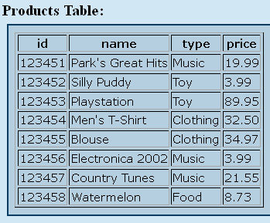
Sample Table

Slide 5
MySQL Aggregate Functions -
GROUP BY
Group BY is good for retrieving information about a group of data.
If you only had one product of each type, then GROUP BY would not be all that useful.
GROUP BY only shines when you have many similar things. For example, if you have a number of products of the same type, and you want to find out some statistical information like the minimum, maximum, or other top-level info, you would use GROUP BY.

Slide 6
Some technical rules of GROUP BY:
The column that you GROUP BY must also be in your SELECT statement.
Remember to group by the column you want information about and not the one you are applying the aggregate function on. In our above example we wanted information on the type column and the aggregate function was applied to the price column.

Slide 7

MySQL Aggregate Functions -
GROUP BY
Syntax:
$query = mysql_query
(“SELECT field1, field2, MIN(fieldx) FROM tablename GROUP BY any_of_the_selected_fields”);
Output:
Displays only the record with the MINIMUM value of the SAME GROUP fields.

Slide 8
MySQL Aggregate Functions -
GROUP BY (cont.)
Example:
$query=mysql_query(“SELECT type, MIN(price) FROM products GROUP BY type”);

Slide 9
MySQL Aggregate Functions -
GROUP BY (cont.)
Output based on sample table:
Clothing - $32.50
Food - $8.73
Music - $3.99
Toy - $3.99
Our sample"products" table has four types of products: Music, Toy, Clothing and Food. When we GROUP BY type then we get one result for each of these types.

Slide 10
MySQL Aggregate Functions -
COUNT()
The COUNT function is an aggregate function that simply counts all the items that are in a group.
The "products" table that is displayed above has several products of various types. One use of COUNT might be to find out how many items of each type there are in the table.

Slide 11
MySQL Aggregate Functions -
COUNT() (cont.)
we are going to GROUP BY type to create four groups: Music, Toy, Clothing and Food. For a slight change of pace, let's count the name column to find how many products there are per type.

Slide 12
MySQL Aggregate Functions -
COUNT() (cont.)
Syntax:
$query = "SELECT type, COUNT(name) FROM products GROUP BY type";

Slide 13
MySQL Aggregate Functions - SUM()
SUM is an aggregate function that totals a specific column for a group. The "products" table that is displayed above has several products of various types. One use of SUM might be to find the total of all the items' price for each product type.
Just as we did in the aggregate introduction lesson, we are going to apply the aggregate function to price and GROUP BY type to create four groups: Music, Toy, Clothing and Food.

Slide 14
MySQL Aggregate Functions - SUM()
Syntax:
SUM(DISTINCT expression)
Example:
SELECT FORMAT(SUM(quantityOrdered * priceEach),2) total
FROM orderdetails
WHERE orderNumber = 10100;

Slide 15
MySQL Aggregate Functions –
AVG()
The MySQL AVG function is an aggregate function that allows you to calculate the average value of a set of values or an expression.
You use the DISTINCT operator in the AVG function to calculate the average value of the distinct values. For example, if you have a set of values 1,1,2,3, the AVG function with DISTINCT operation will return two i.e., (1 + 2 + 3) / 2.

Slide 16
MySQL Aggregate Functions –
AVG()
Syntax:
AVG(DISTINCT expression)
Example:
SELECT FORMAT(
AVG(IF(productline='Classic Cars',buyprice,NULL)) /AVG(buyprice) ,2) 'Classic Cars/ Products’
FROM products;

Slide 17
MySQL Aggregate Functions –
MIN()
The MIN function returns the minimum value in a set of values. The MIN function is very useful in some scenarios such as finding the smallest number, selecting the least expensive product, getting the lowest credit limit, etc.

Slide 18
MySQL Aggregate Functions –
MIN()
Syntax:
MIN(DISTINCT expression)
Example:
SELECT MIN(buyPrice) FROM products;

Slide 19
MySQL Aggregate Functions –
MAX()
The MySQL MAX function returns the maximum value in a set of values.
The MAX function is handy in many queries such as finding the greatest number, the most expensive product, and the largest payment from customers.

Slide 20
MySQL Aggregate Functions –
MAX()
Syntax:
MAX(DISTINCT expression)
Example:
SELECT MAX(amount) FROM payments;

Slide 21
MySQL Join table
The act of joining in MySQL refers to smashing two or more tables into a single table. This means everything you have learned so far can be applied after you've created this new, joined table.

Slide 22
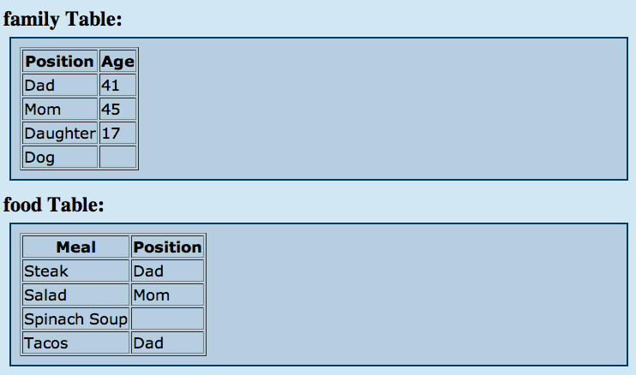
MySQL Join table (cont.)
Example:

Slide 23
MySQL Join table (cont.)
The important thing to note here is that the column Position contains information that can tie these two tables together. In the "family" table, the Position column contains all the members of the family and their respective ages. In the "food" table the Position column contains the family member who enjoys that dish.
It's only through a shared column relationship such as this that tables can be joined together, so remember this when creating tables you wish to have interact with each other.

Slide 24
MySQL Join table (cont.)
Let's imagine that we wanted to SELECT all the dishes that were liked by a family member. If you remember from the previous lesson, this is a situation when we need to use the WHERE clause. We want to SELECT all the dishes WHERE a family member likes it.
We will be performing a generic join of these two tables using the Position column from each table as the connector.

Slide 25
MySQL Join table (cont.)
Syntax:
$query = mysql_query(“SELECT tablename.field1, tablename.field2 FROM table1, table2 WHERE table1.commonfield= table2.commonfield”);

Slide 26
MySQL Join table (cont.)
Example:
$query = mysql_query(“SELECT family.Position, food.Meal FROM family, food WHERE family.position = food.position”);

Slide 27
MySQL Join table (cont.)
OUTPUT:
Dad - Steak
Mom - Salad
Dad - Tacos

Slide 28
References:
http://www.tizag.com/mysqlTutorial/mysqlgroupby.php
http://www.tutorialspoint.com/mysql/mysql-data-types.htm
http://zetcode.com/databases/mysqltutorial/datatypes/
http://www.tutorialspoint.com/mysql/mysql-min-function.htm
http://www.mysqltutorial.org/mysql-min/
http://www.tutorialspoint.com/mysql/mysql-introduction.htm
Copyright © 2012 Kent Institute of Business & Technology, Sydney
CIV03 - Website Design 2(Design and Development)

